Slide 1
UNIT – 5
Distributed Control System (DCS)

Slide 2
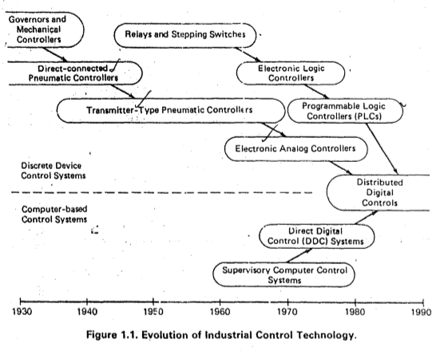
Evolution of Industrial Control

Slide 3
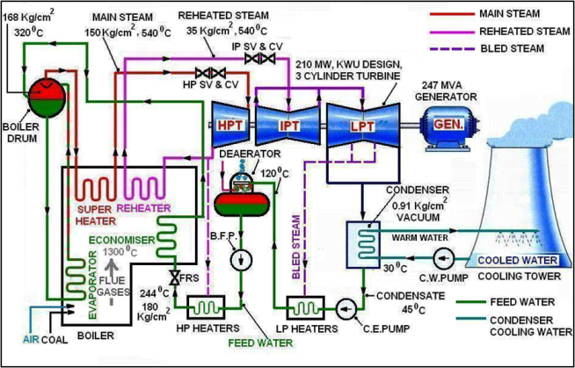
Power plant Layout
In 1958, the first industrial computer was introduced for plant monitoring.

Slide 4
Introduction to control techniques
Direct digital control- A single computer controls the entire process. It overcomes the interfacing problems but is vulnerable to failures and shut down
Hybrid control – An individual discrete-control hardware, typically PLCs or analog loop controllers and a supervisory computer to collect process information and generate reports
Distributed control - allows the application to be broken into subsystems that use digital, rather than analog, control techniques and that can be interfaced together easily.

Slide 5
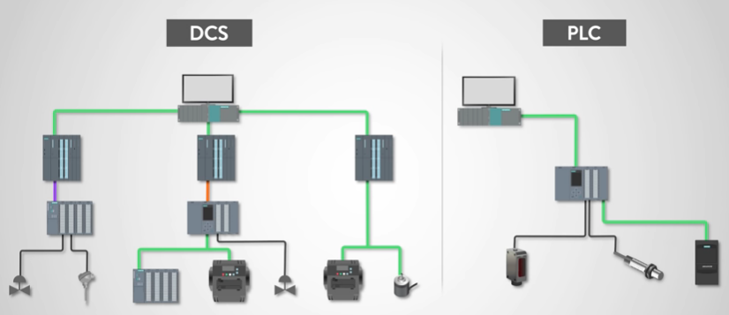
PLC Vs DCS

Slide 6
Hybrid control system
Combination of direct digital control and a central control hardware to implement control functions
Local control of the plant is achieived by means of discrete analog controller
A central monitoring system with SCADA for data logging, control, optimization & alarm management
Dominated approach till 1970s in all industries
Faced difficulties in maintenance of large volumes of data & centralized monitoring of complex industries

Slide 7
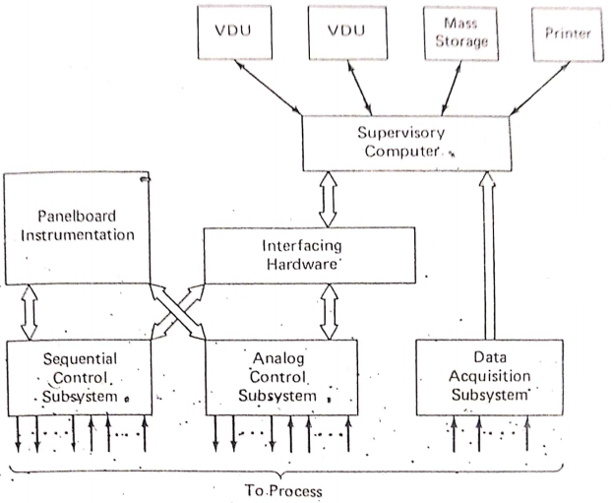
Hybrid architecture
Local control unit & Supervisory computer
LCU- Discrete analog and sequential logic controllers.
Supervisory computer – operating point optimization, alarming, data logging, data storage.

Slide 8
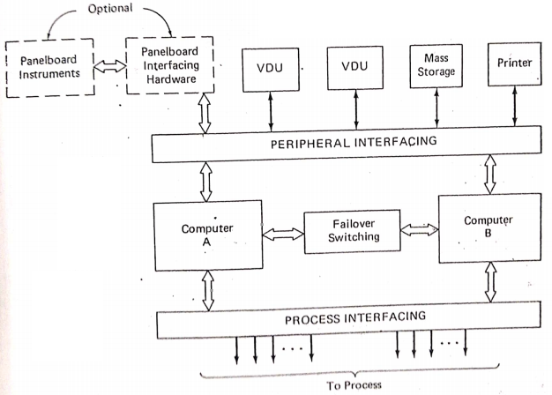
Central computer system architecture

Slide 9
Drawbacks of centralized control
All individual steps in the manufacturing process are handled by a stand-alone central controller
Simple to implement, monitor and troubleshoot
No exchange of controller status
No exchange of data to other controllers
If the main controller fails, the whole process stops

Slide 10
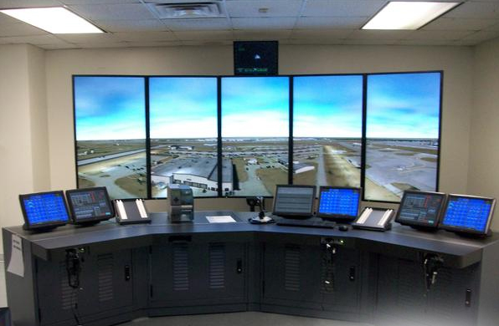
Distributed Control System
Distributed Control System is a specially designed control system used to control complex, large, and geographically distributed applications in industrial processes. In this, controllers are distributed throughout the entire plant area.

Slide 11
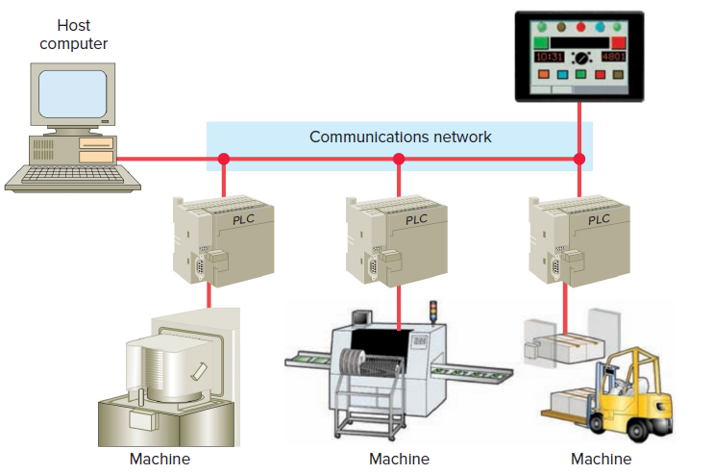
Evolution of Distributed Control System
Distributed Control; Centralized monitoring

Slide 12
Need for distributed control
Distributive control permits the distribution of the processing tasks among several controllers and is highly reliable.
Distributive control drastically reduces field wiring and increases performance because it places the controller and I/O close to the machine process being controlled.
Depending on the process, one PLC failure would not necessarily halt the complete process.
DCS is supervised by a host computer that may perform monitoring/supervising functions such as report generation and storage of data.

Slide 13
Comparison between CCS and DCS
Centralized control system | Distributed control system
Centralised repository | Distributed/ local repositories
Failure of central controller leads to shut down of the entire process | Distribution of the process tasks among several controllers saves from shut down
Less reliable | Highly reliable
Complexity in process dynamics and control affects the speed of operation | Improved speed of operation
Increased field wiring and hence difficult to troubleshoot | Reduced field wiring and so easier to troubleshoot
Need for dedicated communication links | Distributed communication highways
Low installation but high maintenance cost | High initial cost but low maintenance cost
No such centralised supervision of entire process | Supervision of entire process by means of SCADA software

Slide 14
DCS-Manufacturers
Company
Centum (first DCS unit in the year1975)
ABB
Honeywell
Rockwell
Invensys
Siemens
Emerson
Yokogawa

Slide 15
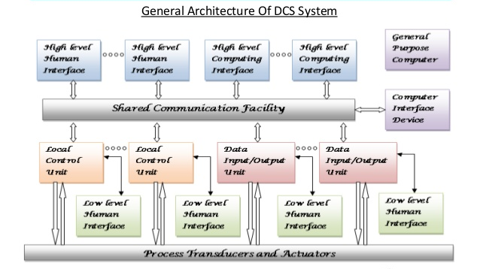
DCS architecture

Slide 16
DCS hardware
Local control unit (LCU)
Data I/O (DIO) modules
Human Machine Interface (HMI)- low and high level
Process interfacing
Shared data communication
Field level communication

Slide 17
Local control Unit (LCU)
Represents a smallest collection of hardware in the DCS setup that performs the closed loop control
Takes inputs from field devices and sensors
Processes commands given by the operator
Controls the output to actuators-motors, solenoids etc.,
Communication between other LCUs
Stand alone operation during changeovers
Changeover from Auto to manual and vice versa

Slide 18
Functions of LCU
It receives the instructions from the engineering station like set point and other parameters and directly controls field devices.
It can sense and control both analog and digital inputs/outputs by analog and digital I/O modules.
It collects the information from discrete field devices and sends this information to operating and engineering stations.

Slide 19
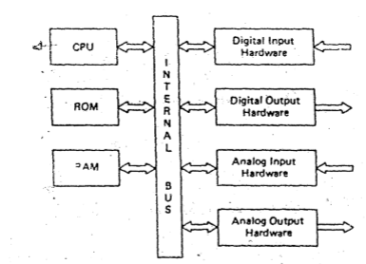
Block diagram of LCU

Slide 20
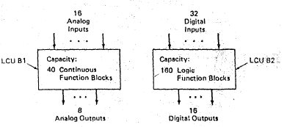
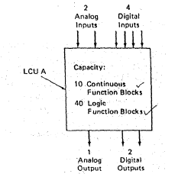
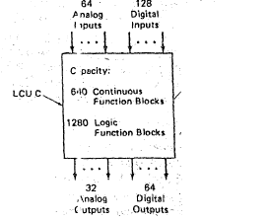
LCU configurations-A,B,C
Configuration A
Configuration B
Configuration C

Slide 21
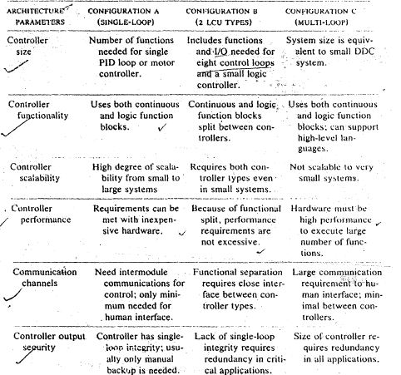
Comparison of configurations
Parameter
Configuration A
Configuration B
Configuration C

Slide 22
Functional Blocks (FB)
To enter the control program and control system configuration in the processor memory of LCU
Blocks with set of parameters can be sequentially connected to implement a particular process
It overcomes the need to learn computer programming
It also helps to avoid manual hardwiring as in the case of relay logic
It helps in easy implementation of the changes to be made in configuration and troubleshooting
Number of FBs used influences the size of the LCU

Slide 23
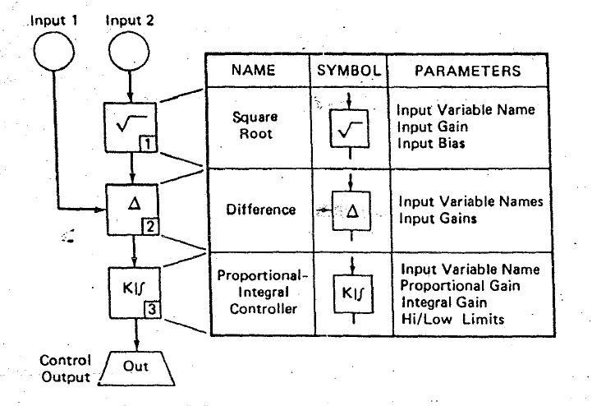
Typical Functional blocks

Slide 24
Functional Block Libraries
2 types of FB libraries:
Complex FB library- for PID controller, sqrt etc.,
Simple FB library- for single arithmetic/logic function
Important factors to be considered- LCU utilization, Flexibility of modification, scalability and difficulty level of implementing algorithms
Important functionalities in High level languages-Text editor, debugger and file manager

Slide 25
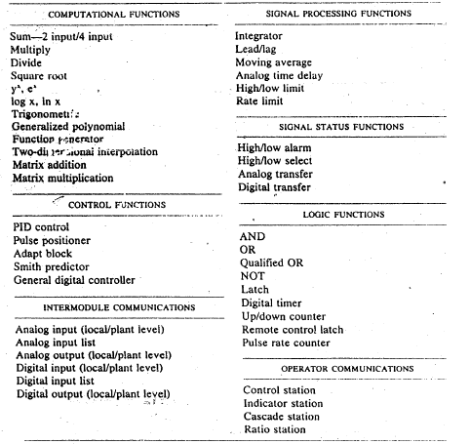
Typical FB libraries

Slide 26
LCU Architecture parameters
Size of the controller- Number of process I/Os and functional blocks that can be executed
Functionality- Mix of function blocks(continuous & logic control, arithmetic functions) Analog/ Digital, Continuous/ Discrete
Performance – Rate at which the controller scan the inputs, processes function blocks and generate outputs. Speed of performance, accuracy, scanning rate etc.,
Communication channels- PC-PC communication, Interface devices, field level communication etc.,
Output security- Fail safe operation, manual or auto backup, frequency of backup and routine checks

Slide 27
Human Machine Interface
Effective Control and visualization of the process
Electronic interfacing between human and the process to monitor, control and diagnose processes
Graphical user interface to check:
Operation summary- routine monitoring of process
Configuration/setup- Control configuration and parametric values
Event history-Time stamped list of all significant events
Auto/manual changeover – Bypass control during shutdown/maintenance
Trend values – Flow, pressure, temperatures as a function of time
Diagnostics –cause and occurrence of failures

Slide 28
Interfacing requirements
Communication Interfaces are needed in order to:
Establish communication between LCUs
Allow transmission of process data to higher level elements
Transmit information command and requests to LCUs
Augment I/O capacity of LCU to DI/DO
Implement redundancy operation of one or more LCUs

Slide 29
Reliable interfacing
For maximum reliability,
Minimise the number of components and electrical connections
Current value of output should be indicated to the LCUs
Powering the output circuitry from an independent supply to avoid loss of data
Analog output device should be able to indicate “last minimum output” “last maximum output” “ go to last output”

Slide 30
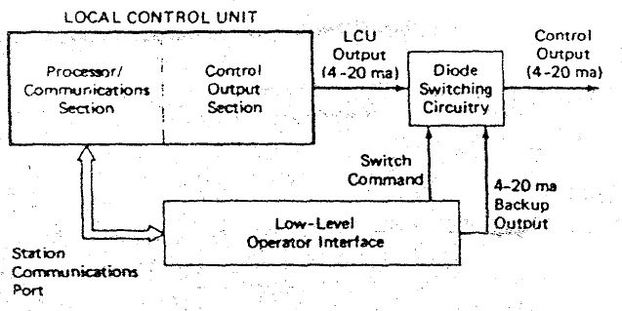
Low level User Interface
Field devices communication
Directly communicates with LCU
Plant operator can directly configure controller, switch control operation and override (Auto/Manual) control

Slide 31
High Level User Interface
Shared interface
Monitor and control the operation of the process
Interfacing with other elements in DCS
Security features required for process application
Modifying the program

Slide 32
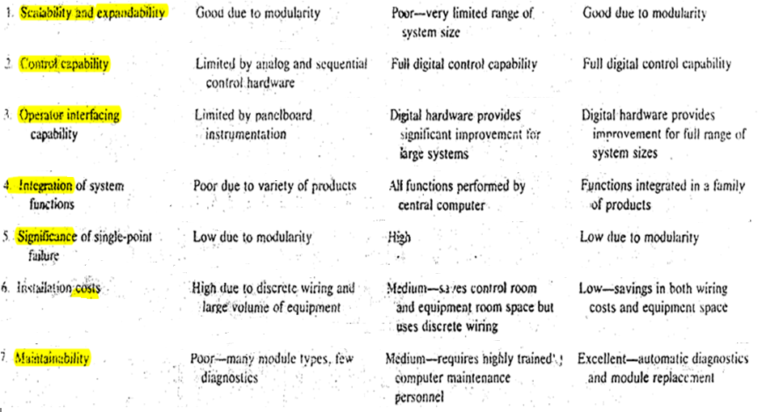
Comparison of architectures
Feature
Hybrid control
Centralized control
Distributed control

Slide 33
Operator Interfaces
The, automated functions that are required for operating an industrial process, for this automated equipment to be used in a safe and effective manner.
however, it is absolutely necessary to have a 'well-engineered human interface system to permit error-free interactions between the humans and the automated system.
Two distinct groups of plant personnel interact with the control system on a regular basis:
Control system engineers-
These people are· responsible for setting up the control system initially, adjusting, and maintaining it from time to time afterwards
Plant operators-
These people are responsible for monitoring, supervising, and running the process through the control system during startup, operation and shutdown conditions.

Slide 34
Low and High Level HMI
As the generalized distributed control system architecture shows, a human interface-capability can be provided at one or both of two levels:
1. Through a low-level human interface (LLHl) connected directly to the local control unit or data input/output unit (DI/OU) via dedicated cabling.
2. Through a high-level human interface (HLHI) connected to an LCU - or DI/OU only through the shared communications facility.

Slide 35
OPERATORS RESPONSIBILITY
Operator interface system should allow the operator to perform the following tasks:
Process Monitoring
Process control
Process diagnostics
Process record keeping

Slide 36
PROCESS MONITORING
Operator interface system should allow the operator to observe and monitor the current state of the process
The values of the process variable must be available for the operator at any time
The values must be accurate
If any malfunctions(sensors)should be readily visible to the operator
Each process variable identifiable by the TAG assigned by instrumentation engineer
Units of the variable should be visible along with the values

Slide 37
PROCESS MONITORING
Some cases the computed variables should be available for the operator
Operator interface should alert the operator with various alarms(low – high)or indicators
Operator interface should display the alarm limits with the process variables
If the system detects multiple alarm condition ,operator interface should indicate the operator with priority of the various alarm conditions
Operator requires trending of the process variable moving condition. Trending graphs should be provided

Slide 38
PROCESS CONTROL
Operator interface should allow the operator to do the following functions to control the process:
1. To access all control loops
2. To change the control modes from auto to manual
3. To perform logic control operations
4. To observe the current status and to initiate new steps or Halt
5. To access and be able to manipulate control variables despite any single point failure

Slide 39
PROCESS DIAGNOSTICS
Operator interface should allow the operator to identify the equipment causing the problem, take measures to correct it,move the process to back normal operation
Diagnostics features:
1. ongoing tests and reasonable checks on the sensors
2. ongoing self tests on the components and modules
3. should display all the process information with alarms for malfunctioning(first out alarms and priority alarming functions)

Slide 40
PROCESS RECORD KEEPING
Record keeping was one of the first functions to be automated using conventional computer
1. Recording of short term trending information
2.manual input of process data
3. recording of alarms
4. periodic records of process variables information
5. long time storage and retrieval of information
6. Record of operator control actions

Slide 41
LOW LEVEL OPERATOR INTERFACE
Directly connected to LCU for controlling and monitoring
Motivations for using LLOI
1. provides an interface to operators trained to use panel board
instrumentation
2. less expensive for small applications
3. can provide manual backup
The devices are used in LLOI:
1. control stations
2. indicator stations
3. alarm annunciators
4. trend recorders

Slide 42
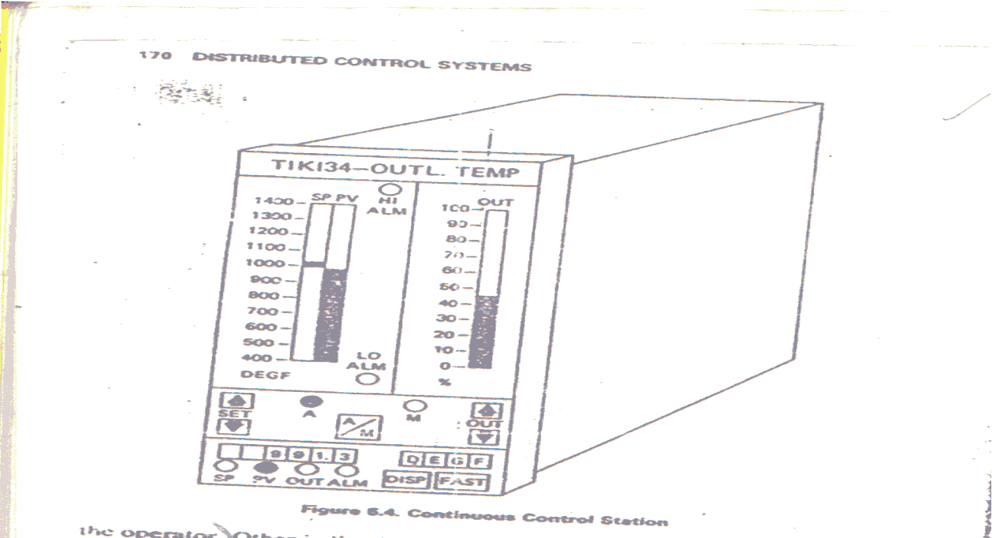
LOW LEVEL OPERATOR INTERFACE
CONTINUOUS CONTROL STATION: one type of panel board instrumentation used in process control system is the manual/automatic station associated with a continuous control loop

Slide 43
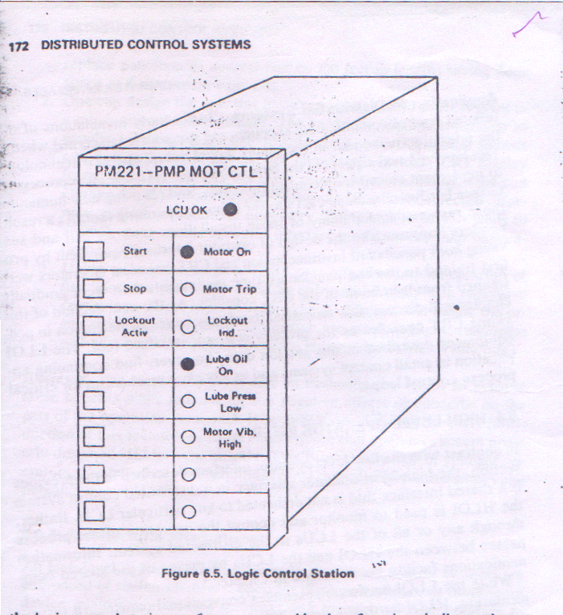
LOW LEVEL OPERATOR INTERFACE
LOGIC STATION: control station for a logic and sequential control system. consists of a set of pushbuttons indicating lights for logic operations.

Slide 44
LOW LEVEL OPERATOR INTERFACE…
SMART ANNUNCIATORS:
It can provide the following functions:
Alarm prioritization
Annunciation and acknowledgement mode options
First-out annunciation

Slide 45
LOW LEVEL OPERATOR INTERFACE…
Selection of Station Components:
The designer should meet the following requirements:
1. Displays and pushbuttons should be sealed against the atmosphere to avoid contamination.
2. Displays should be selected for high visibility in the expected ambient light environment.
3. Each pushbutton when depressed should provide tactile feedback to the operator to minimize potential errors.

Slide 46
LOW LEVEL OPERATOR INTERFACE…
Application in Distributed System:
1. Small control systems
2. Backup mechanism for critical process control loops

Slide 47
HIGH LEVEL OPERATOR INTERFACE
HLOI in a DCS is a shared interface that is not dedicated to any particular LCU.
HLOI is used to monitor and control the operation of the process through any or all of the LCUs in the distributed system.
HLOI hardware uses advanced display technology in console configurations often called video display units (VDUs).
HLOI accepts operator inputs through keyboards instead of the switches, push-buttons, and potentiometers characteristic of conventional operator interface panels.

Slide 48
HIGH LEVEL OPERATOR INTERFACE…
Advantages:
* Control room space is reduced significantly
* More flexible
* Inexpensive

Slide 49
HIGH LEVEL OPERATOR INTERFACE…
Hardware Elements in the Operator
Interface:
Microprocessor and Memory Components
Operator Input and Output Devices
Peripherals
Modular Packaging Approach
Characteristics of Modular Packaging:
* Good design
* Elimination of glare
* Easy accessibility of peripherals
* Simple interconnection of modules

Slide 50
OPERATOR DISPLAYS
INTRODUCTION:
The panel board in a control room uses many square feet of dedicated instruments to provide the operator with the information and mechanisms needed to control the plant.
The VDU in an HLOI system provides a window to the process that allows the operator to see only a relatively small amount of information at any one time on one or more CRT displays.

Slide 51
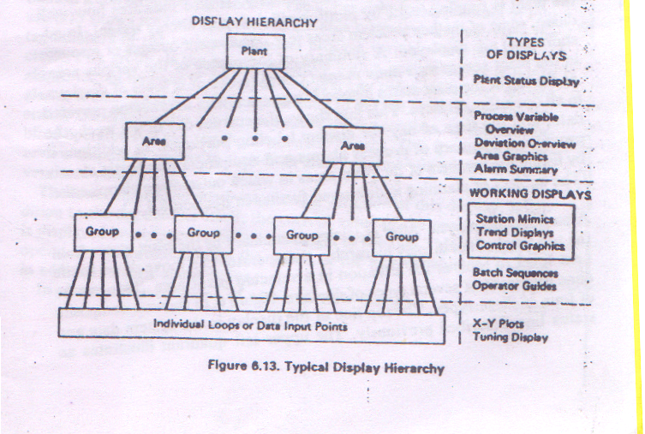
OPERATOR DISPLAYS…
Typical Display Hierarchy:

Slide 52
OPERATOR DISPLAYS…
PLANT LEVEL:
- provides information about the entire plant.
- If plant is large enough, then it can be broken up into several areas of interest.
2. AREA LEVEL:
- provides information concerning the portion of the plant equipment that is related in some way.

Slide 53
OPERATOR DISPLAYS…
3. GROUP LEVEL:
- Displays at this level deal with the control loops and data points relating to a single process unit within a plant area.
4. LOOP LEVEL:
- Displays at this level deal with individual control loop, control sequences and data points.

Slide 54
OPERATOR DISPLAYS…
FEATURES OF GENERAL DISPLAY STRUCTURE:
Covers the full range of detail of information required by the operator.
Allows grouping of available information.
Allows the operator to form a mental model of the relationships of various pieces of information in the plant.

Slide 55
OPERATOR DISPLAYS…
Design Considerations for Displays:
Display should not be cluttered. They must be as simple as possible.
Displays should not be overly “flashy” or have light colored backgrounds.
The top line or two of each display should contain common information of interest to the operator like current date, time, overview of the alarm status.
Color should be used in a consistent way throughout all displays to minimize operator confusion.
Color should not be the only means for communicating with the operator.

Slide 56
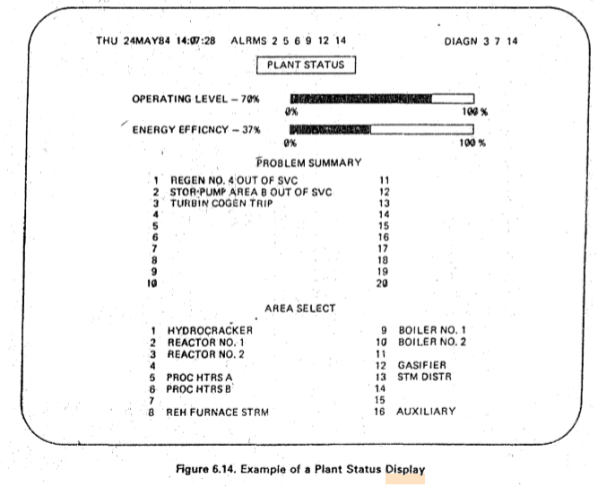
Plant status display

Slide 57
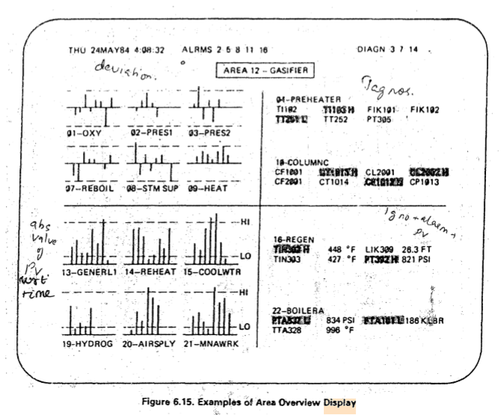
Area overview

Slide 58
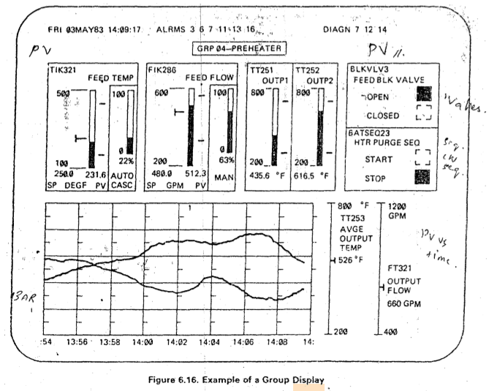
Group display

Slide 59
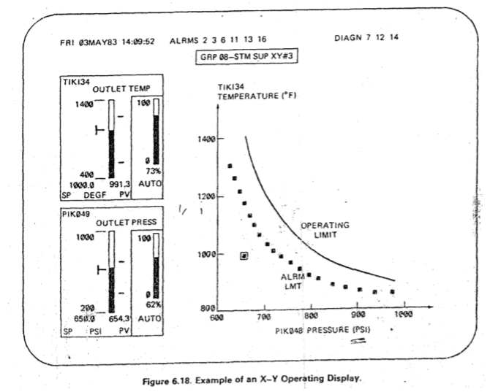
Operator display

Slide 60
ENGINEERING INTERFACE
Levels of Engineering Interface Hardware:
Low level- Minimum function device that are inexpensive and justifiable for small systems.
High Level- Full function devices that are more powerful, that are needed for medium and large sized DCS.

Slide 61
ENGINEERING INTERFACE….
Functions of Engineering Interface Hardware:
System configuration
Operator interface configuration
System documentation
System failure diagnosis

Slide 62
LOW LEVEL ENGINEERING INTERFACE
LLEI is designed to be a minimum function, inexpensive device whose cost is justifiable for small DCS.
It can also be used as a local maintenance and diagnostic tool in large systems.

Slide 63
LOW LEVEL ENGINEERING INTERFACE…
LLEI is usually a microprocessor based device designed either as an electronic module or as a hand held portable device.
To minimize the cost, the device is usually designed with a minimal keyboard or alphanumeric display.
Some LLEIs are connected directly to one LCU and Data I/O unit at a time.

Slide 64
LOW LEVEL ENGINEERING INTERFACE…
System Configuration:
The distributed systems provide a system engineering guide that helps the user, a step by step procedure for hardware configuration.
The primary purpose of the LLEI is to provide a tool for configuring the algorithms in the system controllers.
It is necessary to install a control configuration in a spare controller used to replace a failed controller.

Slide 65
LOW LEVEL ENGINEERING INTERFACE…
Operator Interface Configuration:
LLEI is used only by DCS which are small that have only a limited no. of control loops.
Operator interface is also simple usually consisting of a small no. of dedicated panel board devices.
The connections of panel board instrumentation, between stations and controllers are through hard wiring or cabling. Changes are difficult to make.

Slide 66
LOW LEVEL ENGINEERING INTERFACE…
Documentation:
The automation of documentation of the hardware and control configuration is less or nil.
The documentation is a manual process, with the help of standard forms in the system engineering guide.

Slide 67
HIGH LEVEL ENGINEERING INTERFACE
HLEI allows a user to use the full benefit of the flexibility and control capability of a DCS with minimal cost.
The cost is minimum when used with medium to large scale systems.

Slide 68
HIGH LEVEL ENGINEERING INTERFACE…
HLEI is implemented in the form of a VDU.
The VDU architecture is modular with multiple microprocessors.
This provides increased flexibility.
It interacts with other elements in DCS through the shared communications facility.

Slide 69
HIGH LEVEL ENGINEERING INTERFACE…
System Configuration:
HLEI plays a major role in automating the process of configuring a DCS.
The following information can be stored:
* Definition of any hardware options.
* Definition of each input point.
* Number, type and location of each hardware module.
* Logic state descriptions.
* Control and high level language computational algorithms.

Slide 70
HIGH LEVEL ENGINEERING INTERFACE…
Operator Interface Configuration:
Configure or change its display structure and parameters in a convenient manner.
Should be able to download displays and display hierarchies configured on one engineer’s console to any other operators console.
Steps in Configuring:
To structure a hierarchy of displays.
Define the individual displays.

Slide 71
HIGH LEVEL ENGINEERING INTERFACE…
Documentation:
It can reduce the amount of time required to configure a control system and its associated operator interface.
After the configuration process, all the information defining hardware, control logic, computational algorithms and displays is stored in mass memory.
This make it possible to completely automate the process of documenting.

Slide 72
HIGH LEVEL ENGINEERING INTERFACE…
Design Consideration for documentation:
List of hardware module in DCS.
Documentation of control configuration and associated tuning parameters.
Listing of tags in DCS, special operator functions that are associated with tag.
Definition of operator displays.

Slide 73
HIGH LEVEL ENGINEERING INTERFACE…
Diagnosis of System Problems:
HLEI helps in diagnosing failures and other problems in DCS.
Most of this hardware is microprocessor based and has the intelligence to perform on-line self diagnostics.
Overall diagnostic status is indicated in top line of each display in the HLOI system.
If any problem occurs, then a status alarms goes ON and the operator or engineer can call up a hierarchy of diagnostic displays to pinpoint the problem.

Slide 74
References
Book references:
Krishna Kant, Computer Based Industrial Control, Second edition, Prentice Hall of India, New Delhi,2015
Michael P Lukas, Distributed Control Sytems- their evaluation and design, Van Nostrand Reinhold company, USA, 1986
Video references:
Introduction to DCS
https://www.youtube.com/watch?v=jXRksET5vNo
Difference Between PLC and DCS
https://www.youtube.com/watch?v=iF99iKlDpxA
https://www.youtube.com/watch?v=SM07KPSdlME&t=599s

